Slide 1
Parallel Processing
Diyala University /College of Engineering/Computer Engineering Department

Slide 2
Pipeline and Vector Processing
Based on M. Morris Mano “Computer System Architecture”--Assist. Lecturer Ahmed Salah Hameed

Slide 3
Parallel Processing
Parallel processing is a term used to denote a large class of techniques that are used to provide simultaneous data processing tasks for the purpose of increasing the computational speed of a computer system.
concurrent data processing to achieve faster execution.
The purpose:
Speed up the computer processing capability
Increase the throughput
Throughput the amount of processing that can be accomplished during a given interval of time.
The side effects
The amount of hardware increases
The cost of the system increases

Slide 4
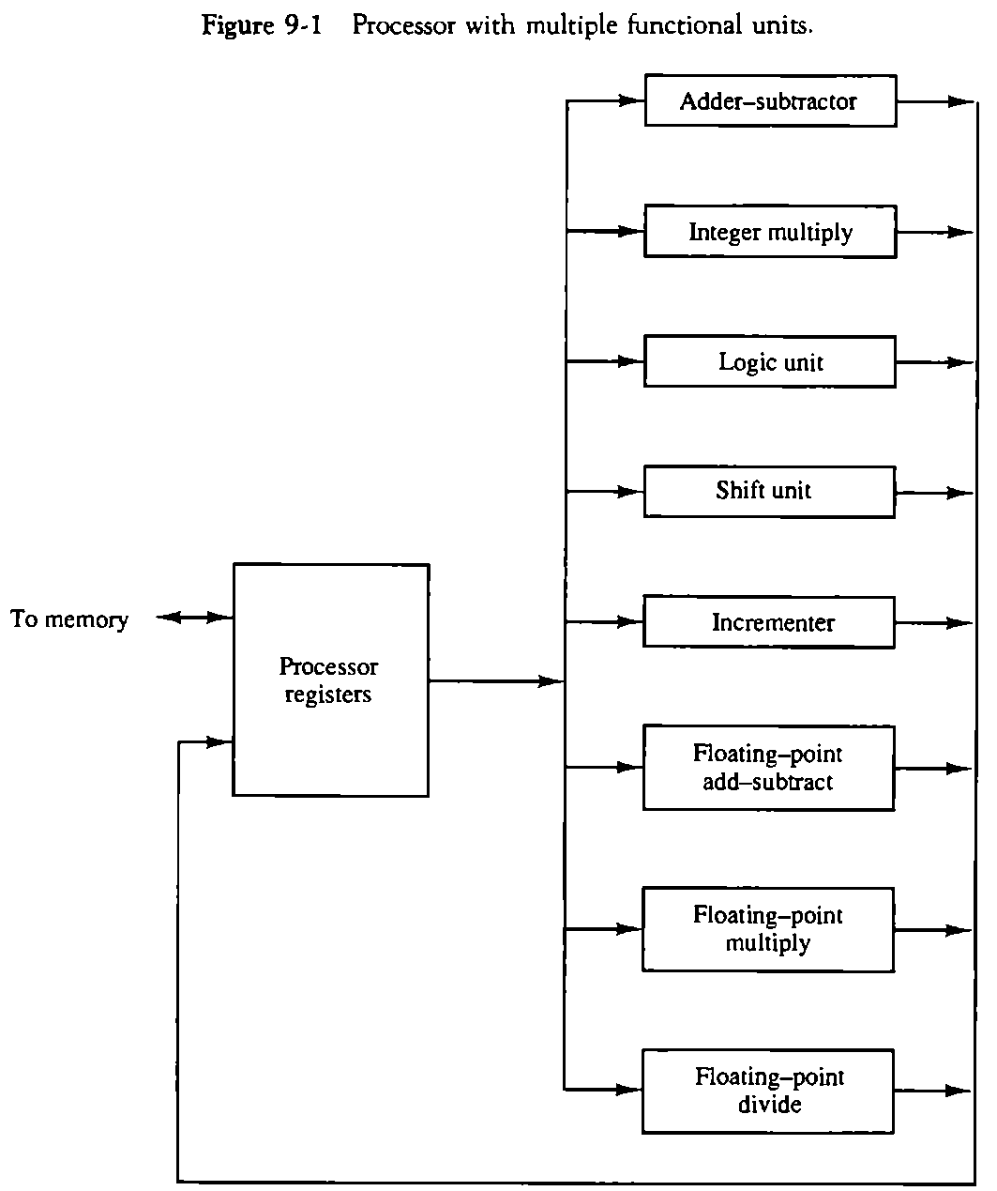
Parallel processing / levels of complexity
At the lower level
Serial Shift register VS parallel load registers
At the higher level
Multiplicity of functional units that perform identical or different operations simultaneously.
Based on M. Morris Mano “Computer System Architecture”--Assist. Lecturer Ahmed Salah Hameed

Slide 5
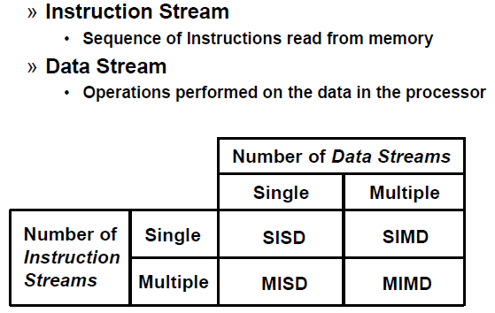
Parallel processing or parallel computers
It can be considered
from the internal organization of the processors
from the interconnection structure between processors
or from the flow of information through the system.
Flynn's classification
Based on M. Morris Mano “Computer System Architecture”--Assist. Lecturer Ahmed Salah Hameed

Slide 6
Flynn's classification
SISD
SIMD
Based on M. Morris Mano “Computer System Architecture”--Assist. Lecturer Ahmed Salah Hameed

Slide 7
Flynn's classification
3. MISD
4. MIMD

Slide 8
Main topics of the Chapter
Pipeline processing : Sec. 9-2
Arithmetic pipeline : Sec. 9-3
Instruction pipeline : Sec. 9-4
Vector processing : adder/multiplier pipeline , Sec. 9-6
Array processing : array processor , Sec. 9-7
Attached array processor : Fig. 9-14
SIMD array processor : Fig. 9-15
Based on M. Morris Mano “Computer System Architecture”--Assist. Lecturer Ahmed Salah Hameed

Slide 9
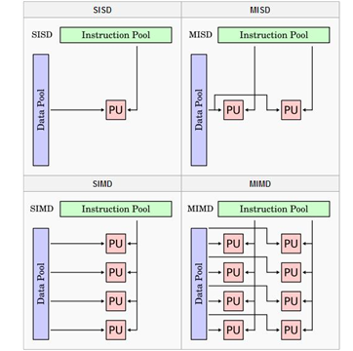
Flynn’s taxonomy classifies computing architectures

Slide 10
SISD COMPUTER SYSTEMS

Slide 11
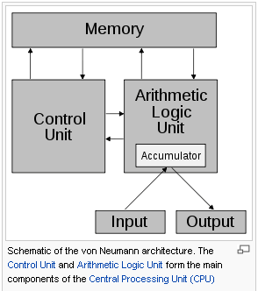
Von Neumann Architecture

Slide 12
MISD COMPUTER SYSTEMS

Slide 13
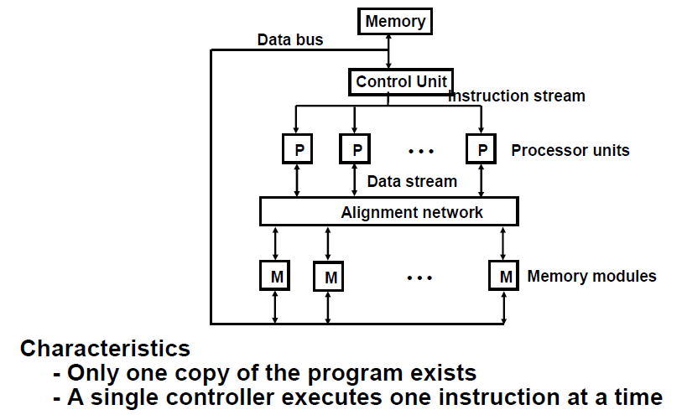
SIMD COMPUTER SYSTEMS

Slide 14
MIMD COMPUTER SYSTEMS

Slide 15
Pipelining
Pipelining is a technique of decomposing a sequential process into sub operations, with each sub process being executed in a special dedicated segment that operates concurrently with all other segments.
A pipeline can be visualized as a collection of processing segments through which binary information flows.
The name “pipeline” implies a flow of information analogous to an industrial assembly line.
Based on M. Morris Mano “Computer System Architecture”--Assist. Lecturer Ahmed Salah Hameed

Slide 16
Example of the Pipeline Organization
Based on M. Morris Mano “Computer System Architecture”--Assist. Lecturer Ahmed Salah Hameed

Slide 17
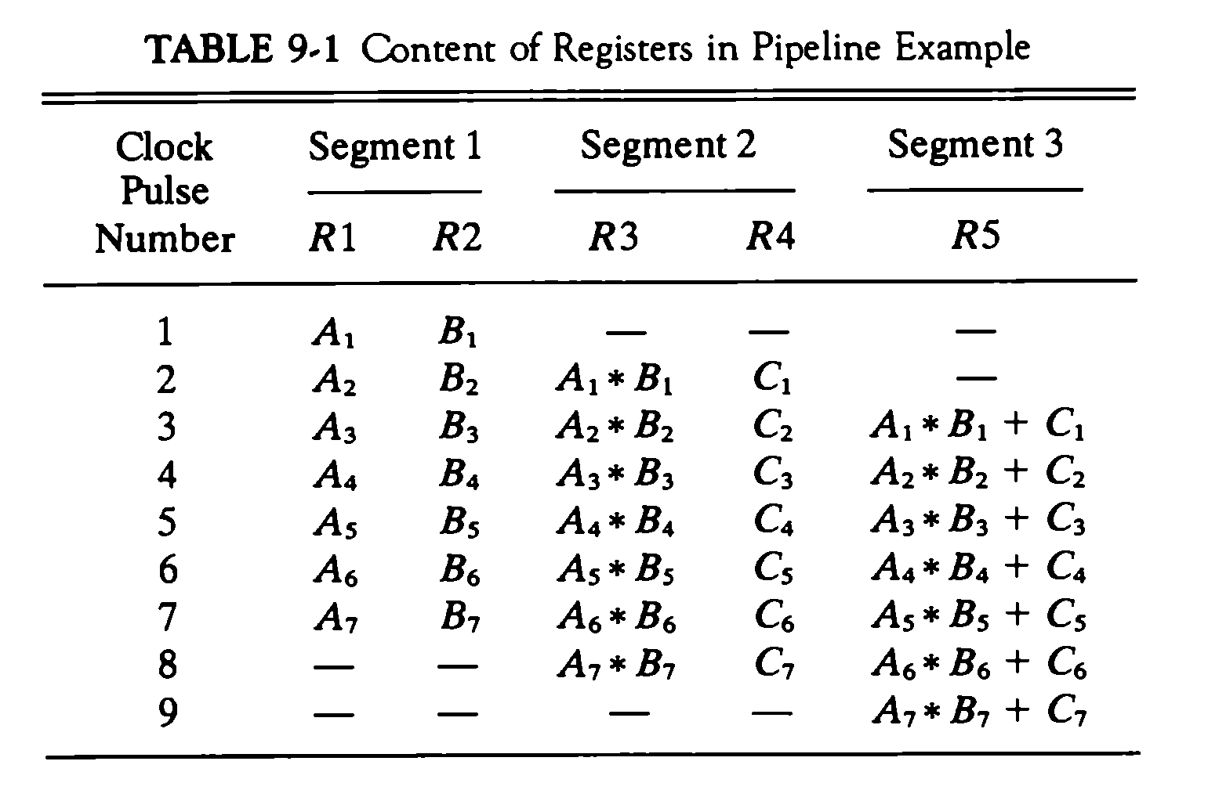
Example of the Pipeline Organization
Based on M. Morris Mano “Computer System Architecture”--Assist. Lecturer Ahmed Salah Hameed

